Slide 1

REMOTE PATIENT MONITORING SYSTEM
TEAM DATABUZZ
SHONIL D’ABREO
NITIN TUNDWAL
MARK PEREIRA
CHRISTANGEL FARGOSE

Slide 2
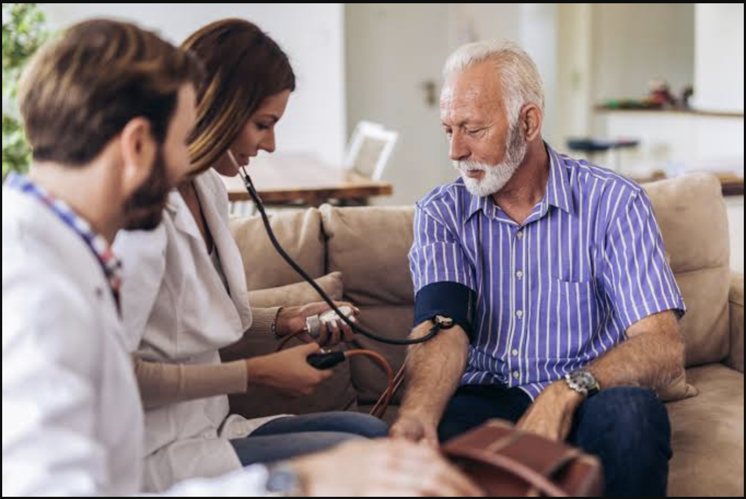
Introduction:
The covid-19 pandemic severely affected the lives of people. As a result, medical checkups were discouraged.
Before pandemic, wearable devices didn't came out useful for chronically ill patients.
Long-term disordered people needed routine checkups to keep up with their health.
The objective is to create an e-health derived Remote Patient Monitoring System to provide valuable health care.
Speaker :- Nitin

Slide 3
PROBLEM DEFINITION:
Chronically ill people who require frequent checkup have been affected the most due to covid.
The ill people need routine monitoring of their health status.
RPMS can be used to remotely assess health by avoiding unnecessary trips and to assist patients for proactive control of their care plan.
It can also be used to provide regular medical advice and insights.
Speaker :- Nitin

Slide 4
Why do we need Remote Patient Monitoring System?
Diversion of health resources due to COVID-19.
Chronic disease patients need special care and treatment.
Useful for elderly people.
Identifies and solves issues quickly.
Changes continuously monitored.
Hospital staff are safer during treatments.
Speaker :- Christangel

Slide 5
Functioning of the RPM system
RPMS is a set of technologies consisting of:-
Patient-end medical devices and mobile application.
Hospital-end web application and AI-powered cloud server.
Speaker :- Shonil

Slide 6
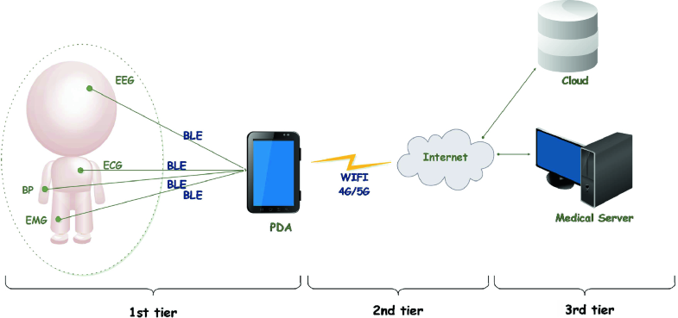
Speaker :- Shonil

Slide 7
Ethical issues and their Solution for RPM system:
Privacy.
Risk of a data breach on both the end.
Compromise on patient’s sensitive information.
Solution:
Encrypting data from both ends.
Creating a HIPAA compliant system.
Speaker :- Mark

Slide 8
Ethical issues and their Solution for RPM system:
2. Fairness.
Insufficient data on young patients having chronic disease.
Solution:
Adding more and complete data on young patients.
Training the system with data on young patients.
Speaker :- Mark

Slide 9
Ethical issues and their Solution for RPM system:
3. Transparency.
Lack of knowledge about how the patients' data is used.
Solution:
Patients will get complete education on how and where the data will be used.
All terms and conditions will be clearly explained to the patients by the operator.
Speaker :- Mark

Slide 10
Ethical issues and their Solution for RPM system:
4. Data Security.
Hackers can hack the sensors and alter or steal the patient’s information.
Solution:
Sensors are not connected directly to the cloud. They are connected to the application through Bluetooth which can reduce the risk of data breach from hackers.
Speaker :- Christangel

Slide 11
Conclusion:
All in one deal
More efficient and safer.
Easy to use.
Ethical issues solution.
Speaker :- Nitin

Slide 12
THANK YOU

